Slide 1


STATISTICS
Session 7: Models & Relationships

Slide 2
A modelling framework
The Real World
Good Fit
Moderate Fit
Poor Fit
Model 1
Model 2
Model 3

Slide 3
A statistical model
The Real World
Model 1
Model 2
Model 3

Slide 4
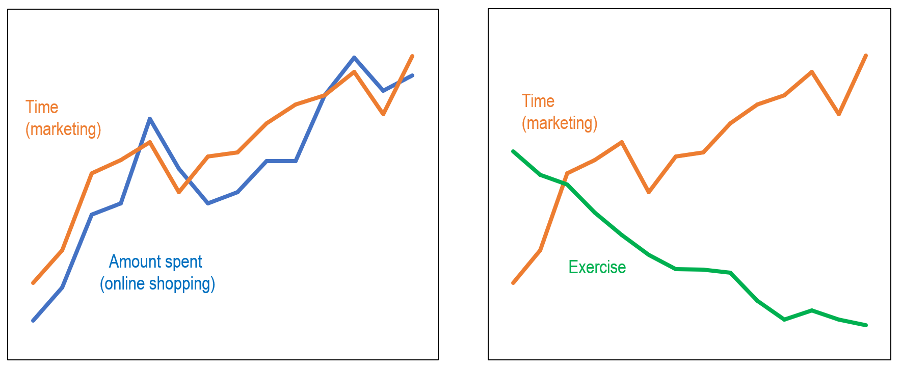
Covariance
Suppose a study was conducted where participants were shown varying amounts of marketing videos at the start of the week (measure as Time in hours). At the end of the week, two other variables were explored for each participant:
Amount spent ($) for online shopping that week
Time spent exercising (mins) that week

Slide 5
Covariance
Positive
Zero
Negative

Slide 6
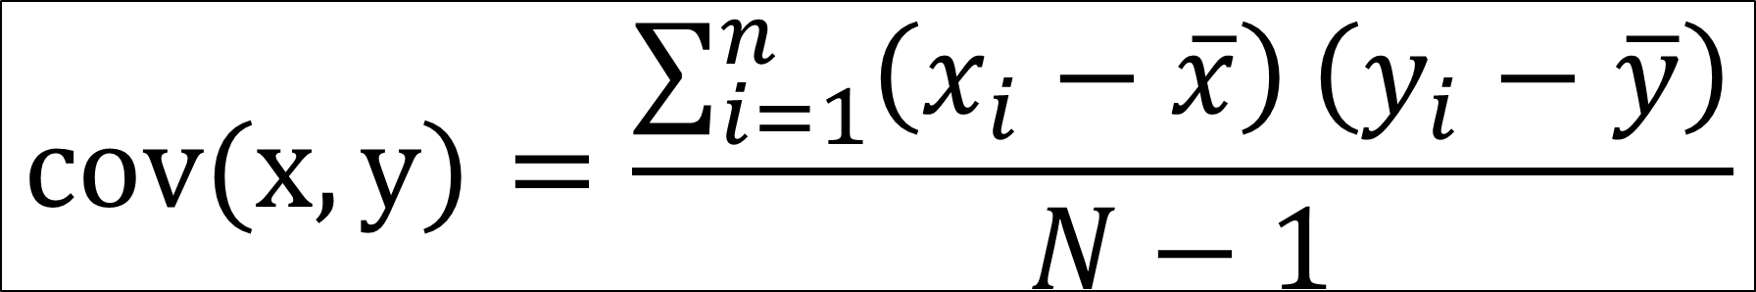
Covariance
Covariance
$$cov(x,y)=\frac{\sum_{i=1}^{n}{\left(x_{i}−\overline{x}\right)}\left(y_{i}−\overline{y}\right)}{N−1}$$

Slide 7


Covariance
Time (mins) | Amount ($)
50 | 80
40 | 90
40 | 100
60 | 130
80 | 150
Mean: 54 | Mean: 110
+40
+20
-10
Mean (Amount)
-30
-20
+26
+6
Mean (Time)
-4
-14
-14
$$Covariance\left(x,y\right)$$
$$=\frac{\sum_{i=1}^{n}{\left(x_{i}−\overline{x}\right)}\left(y_{i}−\overline{y}\right)}{N−1}$$
$$=\frac{\left(−4\right)\left(−30\right)+\left(−14\right)\left(−20\right)+\left(−14\right)\left(−10\right)+\left(6\right)\left(20\right)+(26)(40)}{4}$$
$$=\frac{170}{4}$$
$$=42.5$$

Slide 8


Covariance
Time (mins) | Amount ($)
60 | 80
80 | 90
40 | 100
40 | 130
50 | 150
Mean: 54 | Mean: 110
+40
+20
-10
Mean (Amount)
-30
-20
+26
+6
Mean (Time)
-14
-14
-4
$$Covariance\left(x,y\right)$$
$$=\frac{\sum_{i=1}^{n}{\left(x_{i}−\overline{x}\right)}\left(y_{i}−\overline{y}\right)}{N−1}$$
$$=\frac{\left(6\right)\left(−30\right)+\left(26\right)\left(−20\right)+\left(−14\right)\left(−10\right)+\left(−14\right)\left(20\right)+(−4)(40)}{4}$$
$$=\frac{−280}{4}$$
$$=−70$$

Slide 9
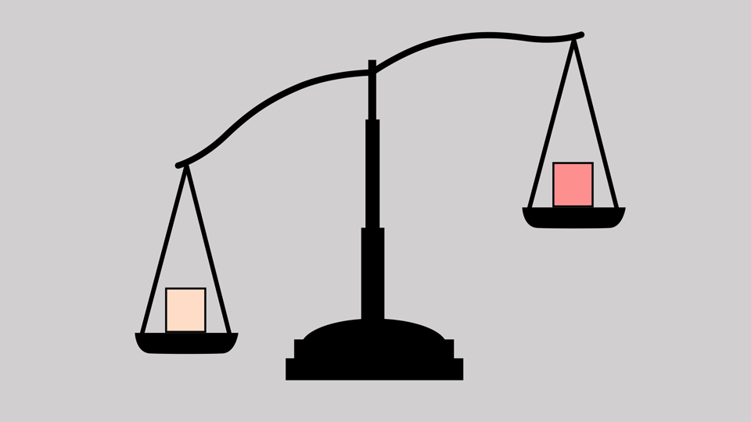
Covariance
The covariance has no built-in scale, and depends entirely on the units of your variables.
For example, right now one of our variables is amount spent in dollars, which gave us a covariance of 42.5.
Now, if I was to switch dollars to cents, the covariance would update as well (to 4250). It’s the same data, the same relationship – however, completely different value!
The covariance is great for identifying the direction of the relationship (positive or negative). However, the covariance is not great at telling us the strength of these relationships.

Slide 10
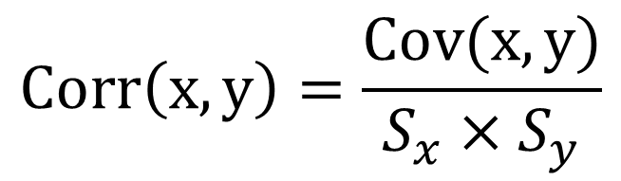
Correlation
By standardising the covariance, we obtain the correlation coefficient – a metric that provides both direction and strength between two variables. Except, unlike covariance, the interpretation of the strength is meaningful.
Covariance of x and y
$$Corr\left(x,y\right)=\frac{Cov(x,y)}{S_{x}{×S}_{y}}$$
Correlation of x and y
Product of Std. deviation of x and Std. deviation for y

Slide 11
Correlation
Negative
Positive
Strength of relationship
-1.00
-0.75
-0.50
-0.25
0
+0.25
+0.50
+0.75
+1.00
No relationship

Slide 12
Correlation
IF
THEN

Slide 13
Correlation is not Causation
Sales | Drownings | Sales | Drownings
12 | 1 | 22 | 5
14 | 2 | 22 | 6
13 | 2 | 26 | 7
15 | 1 | 29 | 5
15 | 3 | 31 | 6
18 | 4 | 30 | 7
19 | 3 | 32 | 8
22 | 4 | 34 | 9
23 | 5 | 35 | 10

Slide 14



Correlation is not Causation

Slide 15

Linear Regression
Regression: a procedure for finding a straight line that comes as close as possible to all the data points in a scatterplot
The regression equation is a formula that describes the regression line and has the basic formula:
Note: When we are only dealing with two variables, this is called simple linear regression
$$y=b_{0}+b_{1}x_{1}+error$$
slope
Intercept / constant

Slide 16
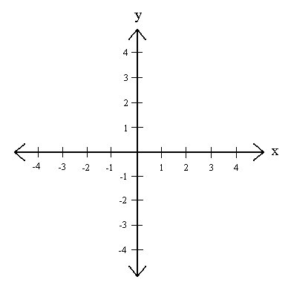

Linear Regression
$$y=b_{0}+b_{1}x_{1}$$
The intercept (b₀) tells us at what particular point does the regression line cross the y-axis when x = 0. Because of this, it is sometimes referred to as the y-intercept.
slope
Intercept / constant

Slide 17
Linear Regression
$$y=b_{0}+b_{1}x_{1}$$
The slope (b₁) tells us how much of an increase there is for y when the x increases by one unit. It is also an indication of how steep the line is.
slope
Intercept / constant

Slide 18





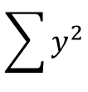

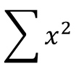

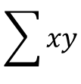

Ordinary Least Squares (OLS)
N Friends
Depression
x | y | xy | x² | y²
8 | 2 | 16 | 64 | 4
1 | 9 | 9 | 1 | 81
5 | 4 | 20 | 25 | 16
10 | 3 | 30 | 100 | 9
5 | 5 | 25 | 25 | 25
8 | 4 | 32 | 64 | 16
6 | 3 | 18 | 36 | 9
5 | 5 | 25 | 25 | 25
6 | 4 | 24 | 36 | 16
10 | 1 | 10 | 100 | 1
64 | 40 | 209 | 476 | 202
$$b_{0}=\frac{\left(\sum{y}\right)\left(\sum{x^{2}}\right)−\left(\sum{x}\right)\left(\sum{xy}\right)}{n\left(\sum{x^{2}}\right)−{\left(\sum{x}\right)}^{2}}$$
$$=\frac{\left(40\right)\left(476\right)−\left(64\right)\left(209\right)}{10\left(476\right)−{\left(64\right)}^{2}}$$
$$=8.53$$
$$b_{1}=\frac{n\left(\sum{xy}\right)−\left(\sum{x}\right)\left(\sum{y}\right)}{n\left(\sum{x^{2}}\right)−{\left(\sum{x}\right)}^{2}}$$
$$=\frac{10\left(209\right)−\left(64\right)\left(40\right)}{10\left(476\right)−{\left(64\right)}^{2}}$$
$$=−0.71$$
$$\sum{x}$$
$$\sum{y}$$
$$\sum{xy}$$
$$\sum{x^{2}}$$
$$\sum{y^{2}}$$
$$Depression=8.53−0.71\left(N Friends\right)+Error$$

Slide 19
Ordinary Least Squares (OLS)
$$Depression=8.53−0.71\left(N Friends\right)+Error$$
10
For each additional increase in number of friends, Depression score decreases by 0.71 points
9
8
Minh
7
6
Ross
Pam
Depression Score
5
Lyn
4
Tom
Amy
Pete
3
Eike
Sam
2
Jill
1
0
1
2
3
4
5
6
7
8
9
10
Number of Friends

Slide 20

Multiple Regression
Simple Linear Regression
Multiple Linear Regression
$$y=b_{0}+b_{1}x_{1}+error$$
$$y=b_{0}+b_{1}x_{1}+b_{2}x_{2}+…b_{k}x_{k}+error$$

Slide 21
Multiple Regression
Suppose we determined a multiple regression model as:
$$Income=−117119+(4540×Education)+(3368×Age)+error$$
For each additional year in Education, income increases by $4540, when we hold other variables constant.
For each additional year in Age, income increases by $3368, when we hold other variables constant.

Slide 22



Multiple Regression
$$Income=−117119+(4540×Education)+(3368×Age)+error$$
Person A
$$Income=−117119+(4540×Education)+(3368×Age)+error$$
Years Edu:
Age:
12
40
$$Income=−117119+(4540×12)+(3368×40)+error$$
$$Income=−117119+(54480)+(134720)+error$$
$$Income=\$72,081$$
Person B
$$Income=−117119+(4540×Education)+(3368×Age)+error$$
Years Edu:
Age:
13
40
$$Income=−117119+(4540×13)+(3368×40)+error$$
$$Income=−117119+(59020)+(134720)+error$$
$$Income=\$76,621$$

Slide 23


Multiple Regression
$$Income=−117119+(4540×Education)+(3368×Age)+error$$
Person A
$$Income=−117119+(4540×Education)+(3368×Age)+error$$
Years Edu:
Age:
12
40
$$Income=−117119+(4540×12)+(3368×40)+error$$
$$Income=−117119+(54480)+(134720)+error$$
$$Income=\$72,081$$
Person B
$$Income=−117119+(4540×Education)+(3368×Age)+error$$
Years Edu:
Age:
13
40
$$Income=−117119+(4540×13)+(3368×40)+error$$
$$Income=−117119+(59020)+(134720)+error$$
$$Income=\$76,621$$

Slide 24
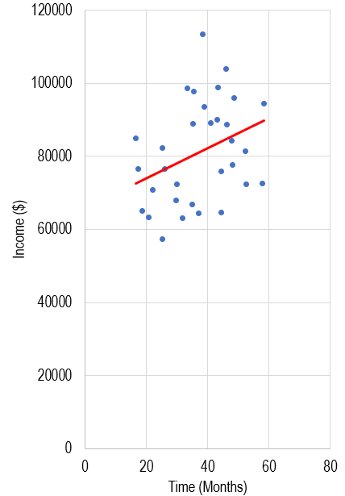
R² and Goodness of Fit
R² (also called coefficient of determination) is a statistical measure of how well the regression model explains the variability of the response variable.
  In simple linear regression, 𝑅² is the square of the correlation coefficient between the observed and predicted values.
  In multiple regression, it is the proportion of variance in the response variable explained collectively by all predictors.
R² is always between 0 and 1:
  In general*, the higher the R², the better the model fits your data.
* Need to be mindful of overfitting models

Slide 25
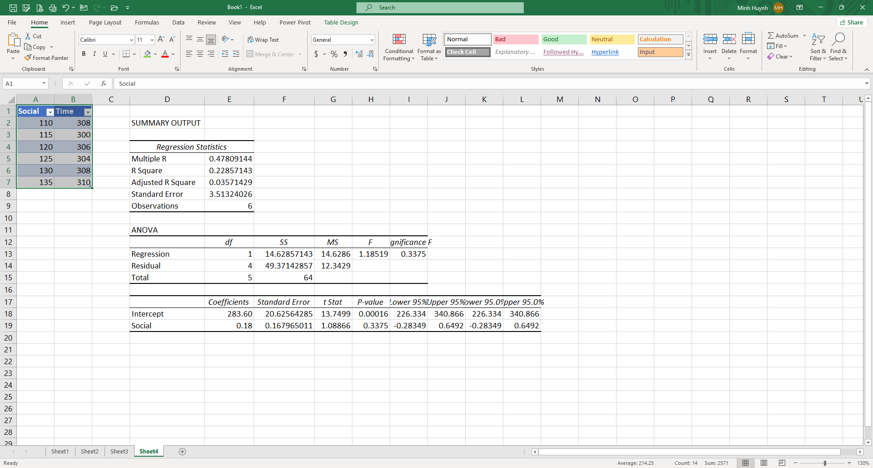

R² and Goodness of Fit
$$\frac{{SS}_{Regrerssion}}{{SS}_{Total}}=\frac{14.63}{64}=0.229$$

Slide 26
R² and Goodness of Fit
Note: R² is suitable for you are dealing with simple linear regression

Slide 27
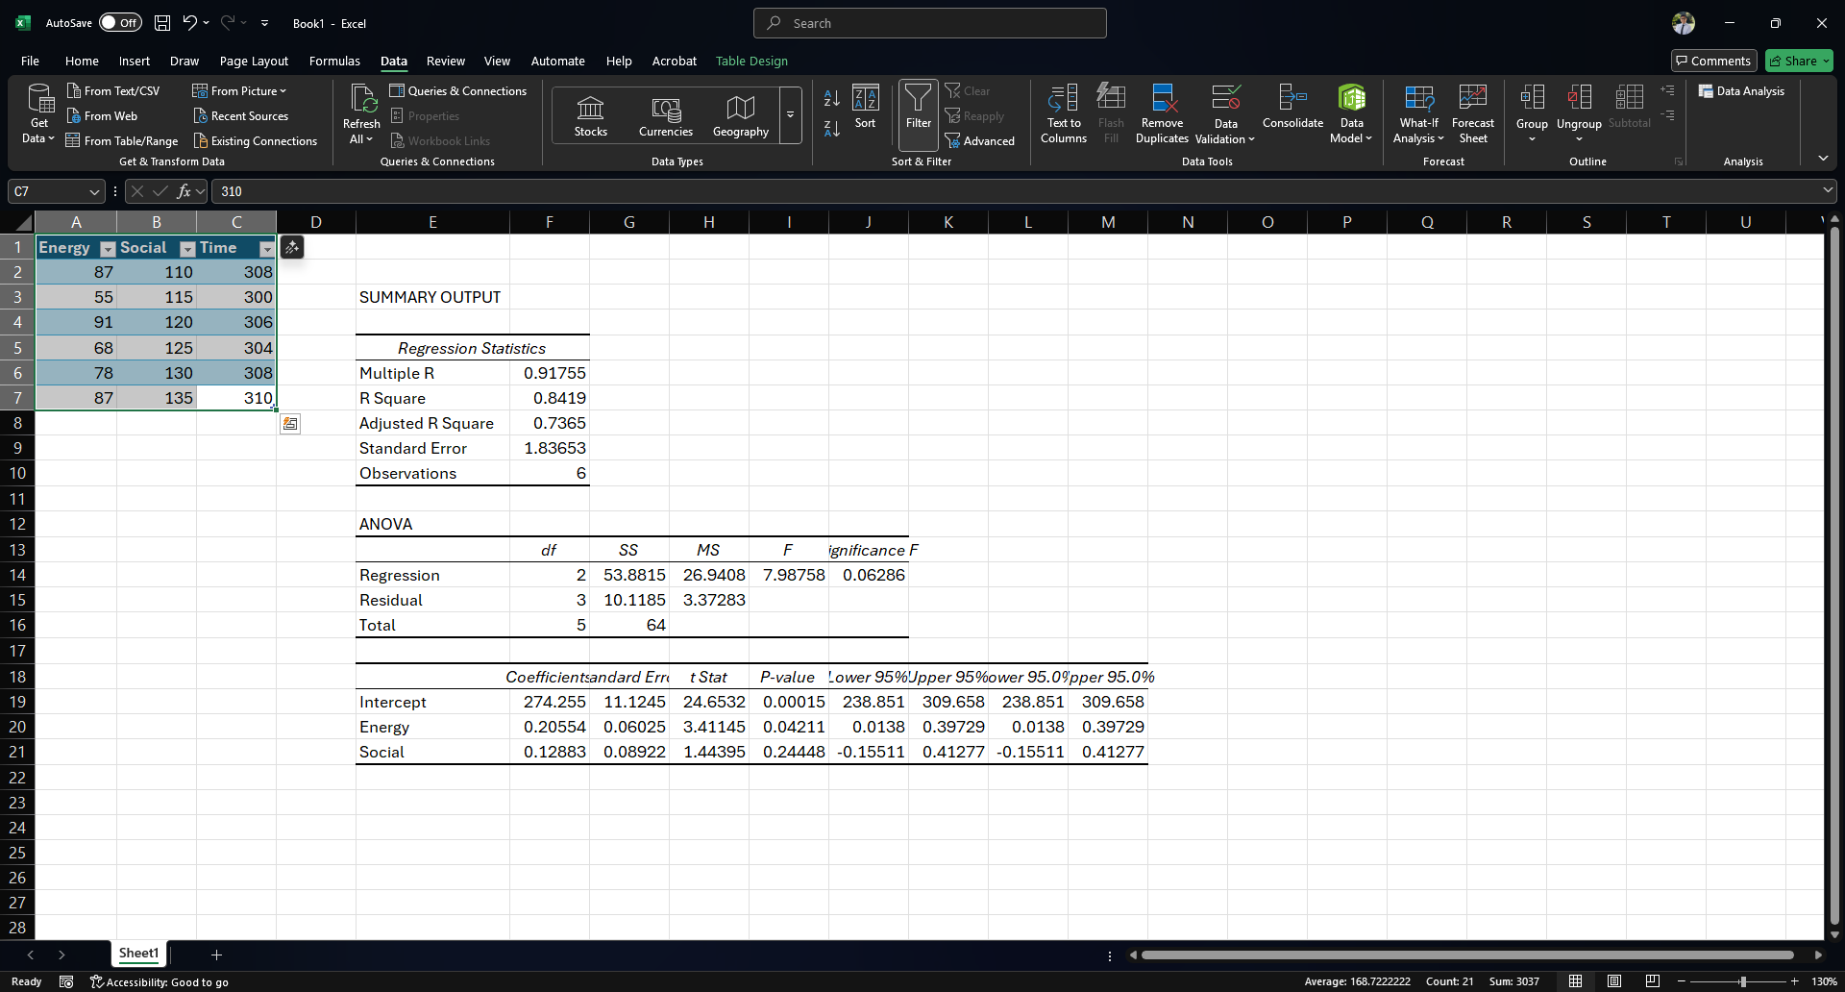
Adjusted R² and Multiple Regression
It would be better to use Adjusted R² for multiple regression
Suppose we have a multiple regression problem instead

Slide 28
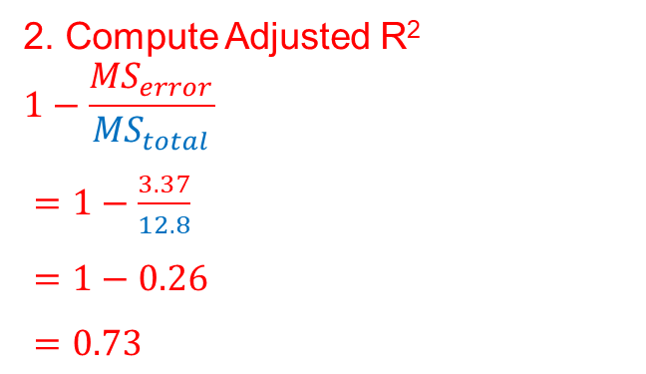
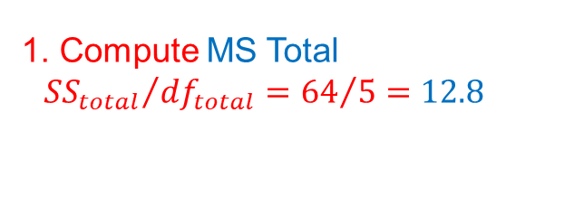
Adjusted R² and Multiple Regression
1. Compute MS Total
$${ {SS}_{total}}/{{df}_{total}={64}/5=12.8}$$
2. Compute Adjusted R²
$$1−\frac{{MS}_{error}}{{MS}_{total}}$$
$=1−\frac{3.37}{12.8}$
$=1−0.26$
$=0.73$

Slide 29
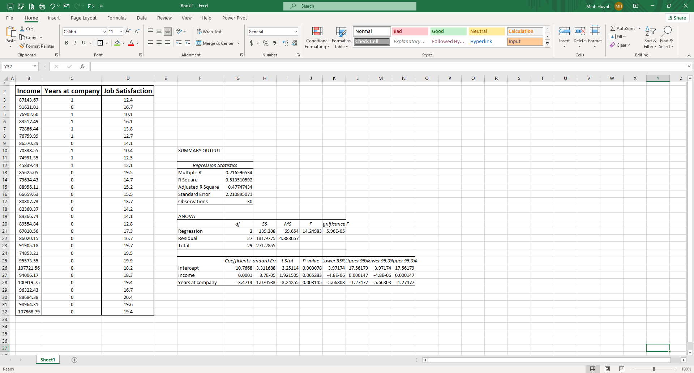
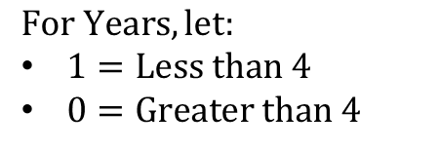
Multiple Regression with a binary predictor
$$Job Satisfaction=b_{0}+b_{1}Income+b_{2}Years$$
$$For Years, let:$$
$1=Less than 4$
$0=Greater than 4$
$$Job Satisfaction=10.7668+0.0001(Income)−3.4714(Years)$$

Slide 30
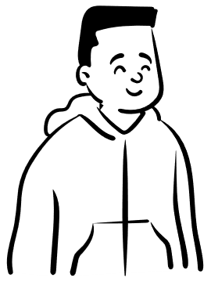



Multiple Regression with a binary predictor
$$Job Satisfaction=10.7668+0.0001(Income)−3.4714(Years)$$
Person A
Income: 75,000
Years: “Less than 4” (1)
$$Job Satisfaction=10.7668+.0001\left(75000\right)−3.4714(1)$$
$$Job Satisfaction=10.7668+7.5−3.4714$$
$$Job Satisfaction=14.7953$$
Person B
Income: 75,000
Years: “More than 4” (0)
$$Job Satisfaction=10.7668+.0001\left(75000\right)−3.4714(0)$$
$$Job Satisfaction=10.7668+7.5−0$$
$$Job Satisfaction=18.2667$$

Slide 31
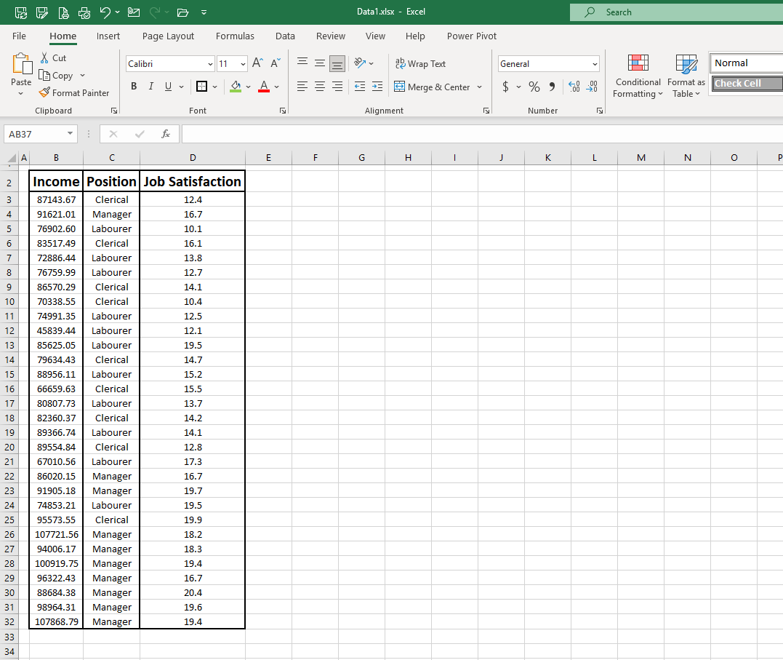
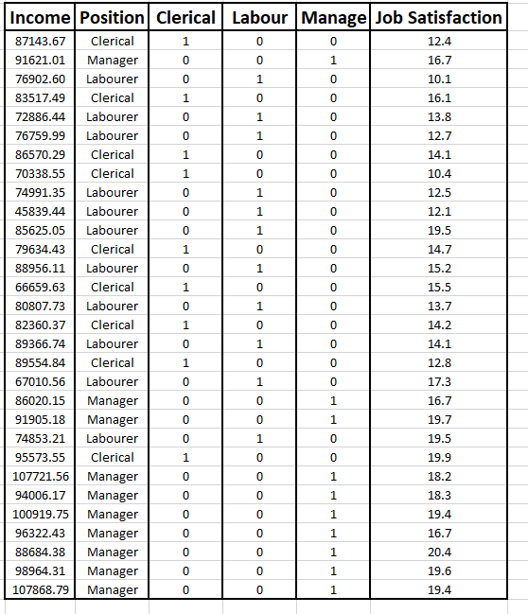
Multiple Regression with a categorical (k > 2) predictor
We need to choose one of the levels to be a reference category, e.g.:
Here we have chosen “Manager” to be the reference category, so it does not have a term in the model.
$$b_{0}+b_{1}Income+b_{2}Clerical+b_{3}Labourer$$

Slide 32
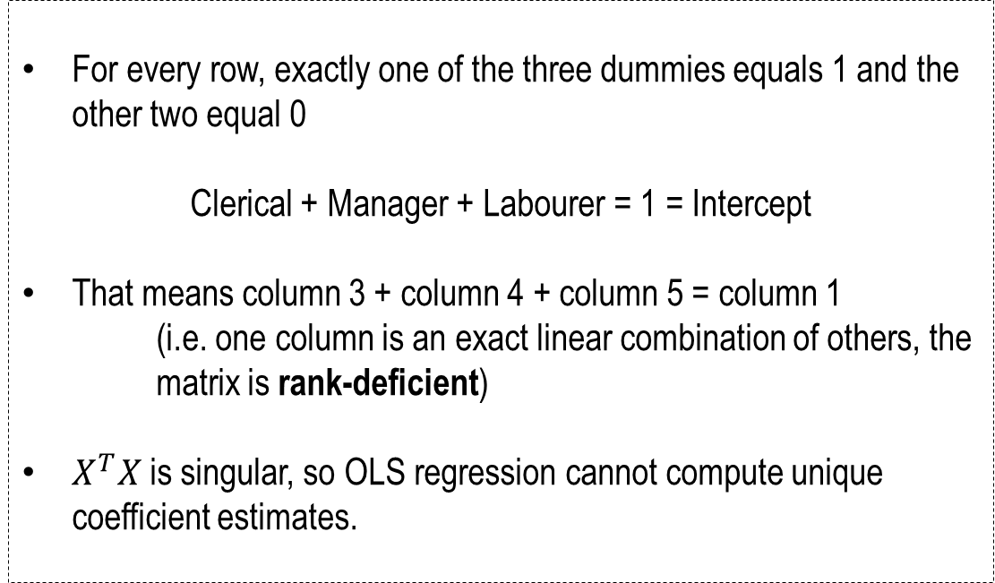
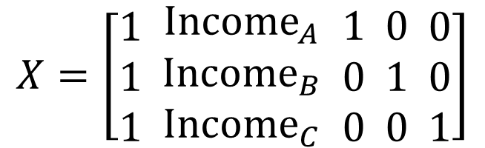
Multiple Regression with a categorical (k > 2) predictor
For every row, exactly one of the three dummies equals 1 and the other two equal 0
Clerical + Manager + Labourer = 1 = Intercept
That means column 3 + column 4 + column 5 = column 1
(i.e. one column is an exact linear combination of others, the matrix is rank-deficient)
$X^{T}X$ is singular, so OLS regression cannot compute unique coefficient estimates.
$$X=\left[\begin{matrix}1 \\ 1 \\ 1\end{matrix} \begin{matrix}{Income}_{A} \\ {Income}_{B} \\ {Income}_{C}\end{matrix} \begin{matrix}1 \\ 0 \\ 0\end{matrix} \begin{matrix}0 \\ 1 \\ 0\end{matrix} \begin{matrix}0 \\ 0 \\ 1\end{matrix}\right]$$

Slide 33
Interaction Effects
INTERACTION
Moderator
Interaction
Time (violent games)
Aggression

Slide 34
Interaction Effects

Slide 35
Interaction Effects
The combined effect of two variables on another is conceptually known as moderation (or interaction)
Mathematically, a moderator is the product of two variables (e.g. variable 1 x variable 2)
We can use Excel to determine whether or not a moderator is significant using the Data Analysis tool kit
However, to obtain individual regression equations we’ll have to compute a moderator and do some (simple) maths

Slide 36
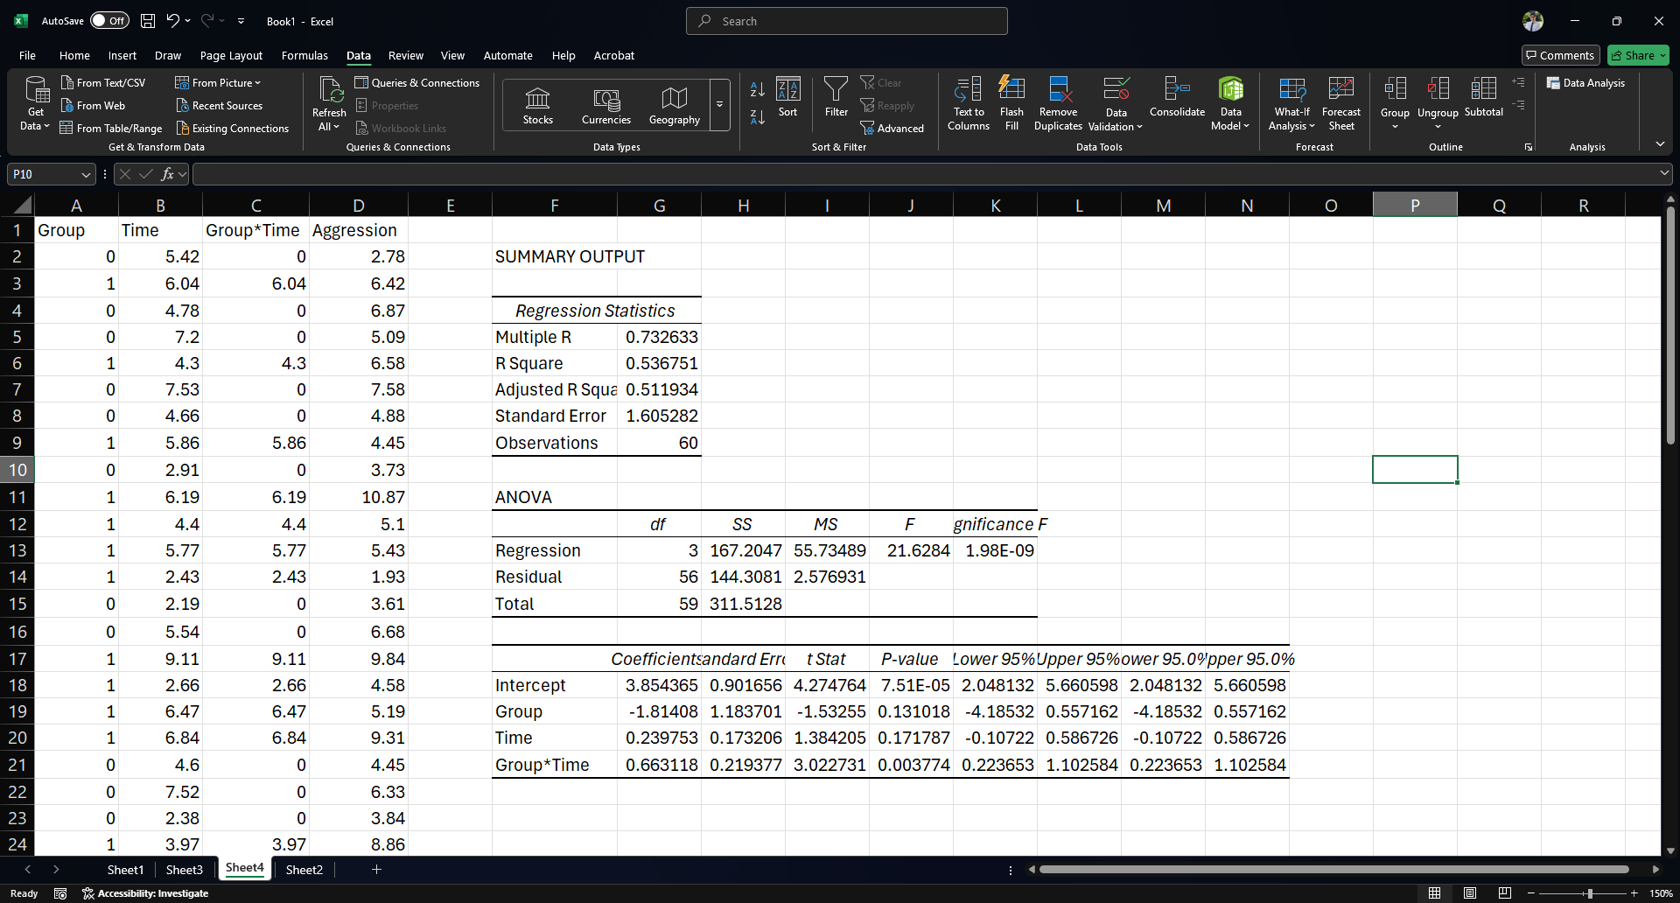
Interaction Effects

Slide 37
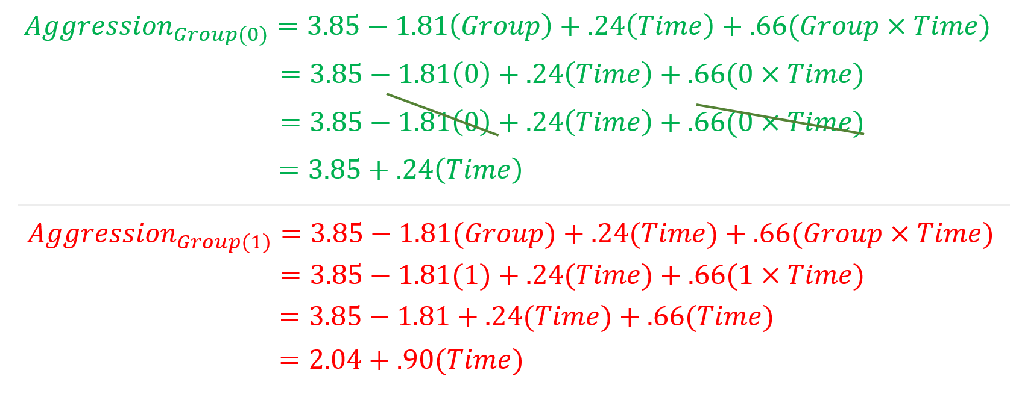
Interaction Effects
$$Aggression=3.85−1.81\left(Group\right)+0.24\left(Time\right)+0.66(Group×Time)$$

Slide 38


Interaction Effects
$$2.04+.90(Time)$$
$$3.85+.24\left(Time\right)$$

Slide 39
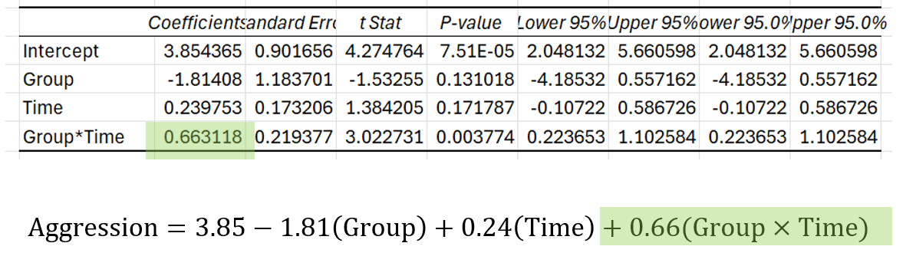
Interaction Effects
$$2.04+.90(Time)$$
$$3.85+.24\left(Time\right)$$

